Slide 1

Objects in JavaScript
1h

Slide 2
RECAP: JavaScript Language
JavaScript® (often shortened to JS) is
a lightweight,
interpreted, (??? no !, it is actually compiled)
object-oriented language
with first-class functions,
and is best known
as the scripting language for Web pages,
but it's used in many non-browser environments as well
It is a prototype-based,
multi-paradigm scripting language
that is dynamic,
and supports
object-oriented,
imperative,
and functional programming styles
https://developer.mozilla.org/en-US/docs/Web/JavaScript/About_JavaScript

Slide 3
object-oriented language
It has object data type
It has object literal {} and other object constuctors
Objects can have members: properties and methods
Even primitive data types have methods ;-)
Build-ins are implemented as objects with methods and properties
It has new operator and constructors
It has this keyword, representing parent object in methods
It has inheritance and prototypes
objects are by default inherited from single root (Object)
It has notion of static and instance members (statics are members of function)
It has Symbol to create private members
It has reflexion and introspection APIs
And now finnaly has Classes

Slide 4
object-oriented language
JS DOES NOT have classes
it is syntactic sugar over prototypes
JS have decorators
on those classes
JS have getters and setters
on those classes, and on objects
JS DOES NOT have packages or namespaces
we just simulate them with modules and returned objects
JS DOES NOT have aspects
We just simulate them with functional concepts
JS DOES NOT have multiple class inheritance
Do we really need this ?
in JS you don't need classes nor prototypes to create object
... ??? Anything else you need in OO language ???

Slide 5
Roles of Objects In Programming
Objects as implementation metaphor
Objects as data
Program consists of objects that talk together by method calls and have internal state
Program devided to designed objects and methods
Using inheritance for business
Inheritance for implementation abstraction
private/public state
...
Program consists of function working with data. Taking input and producing output. Combined together to create logic
Objects represent data
Complex data structures, often deeply nested, cyclic data, graphs
Functions for object traversal and object manipulations
Immutability
Serialization/Deserialization
...

Slide 6
Objects basics
properties, members,....

Slide 7
Objects and properties
JavaScript objects are dynamic "bags" of properties, properties can be added or deleted at any time, and are independent of any class definition
object has members: properties and methods
property can be one of:
primitives – string, number, boolean, null, undefined, symbol
object – array, date, …. and of course function (method)
syntax for defining and accessing properties
properties can be own and not-own (inherited)
properties can be enumerable, configurable, writable
getters and setters
inspecting objects

Slide 8
Creating Objects
Object Literal {}
Rýchly, jednoduchý zápis
....
new Object([value])
Dynamický typ objektu podľa value
....
Object.createObject()
Pokročilý zápis (konfigurácia správania/druhov properties ....)
....

Slide 9
Defining object properties
V JS mame niekoľko možnosti:
Základne sú:
literal or initializer notation
Member assignment (z . bodkou)
Member assignment (z [] hranatymi zatvorkami)
Advanced sú:
Computed property names
Spread properties for object literals
Rest properties for object destructuring
Shorthand property names
Shorthand method names
Getter and Setters
Object.defineProperty (createObject) (cela sekcia o tomto)
https://developer.mozilla.org/en-US/docs/Web/JavaScript/Reference/Operators/Object_initializer

Slide 10
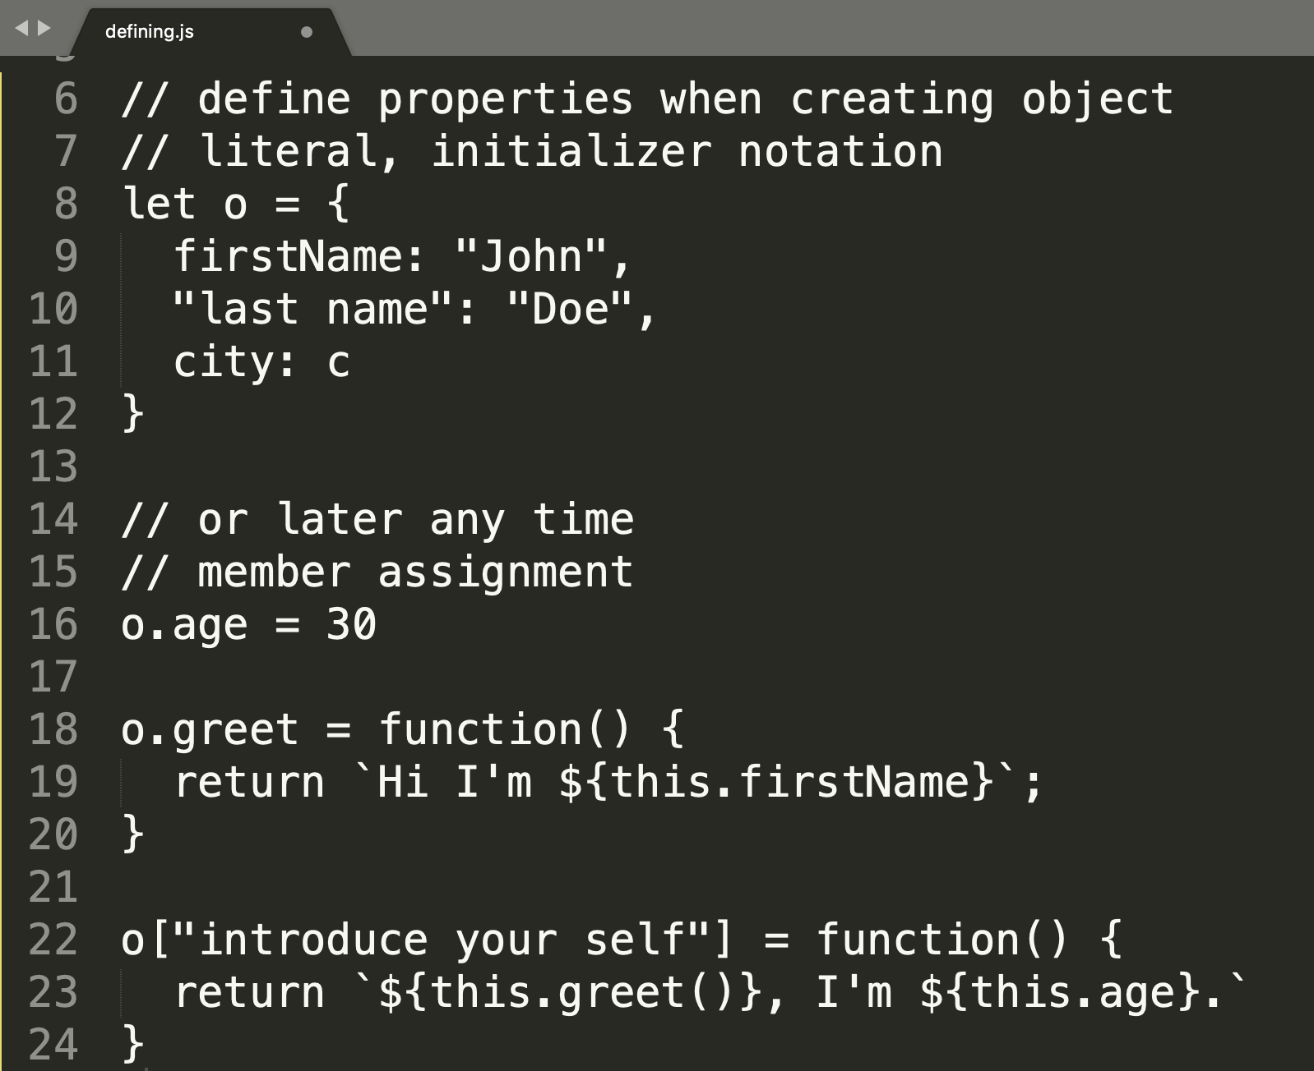

Slide 11
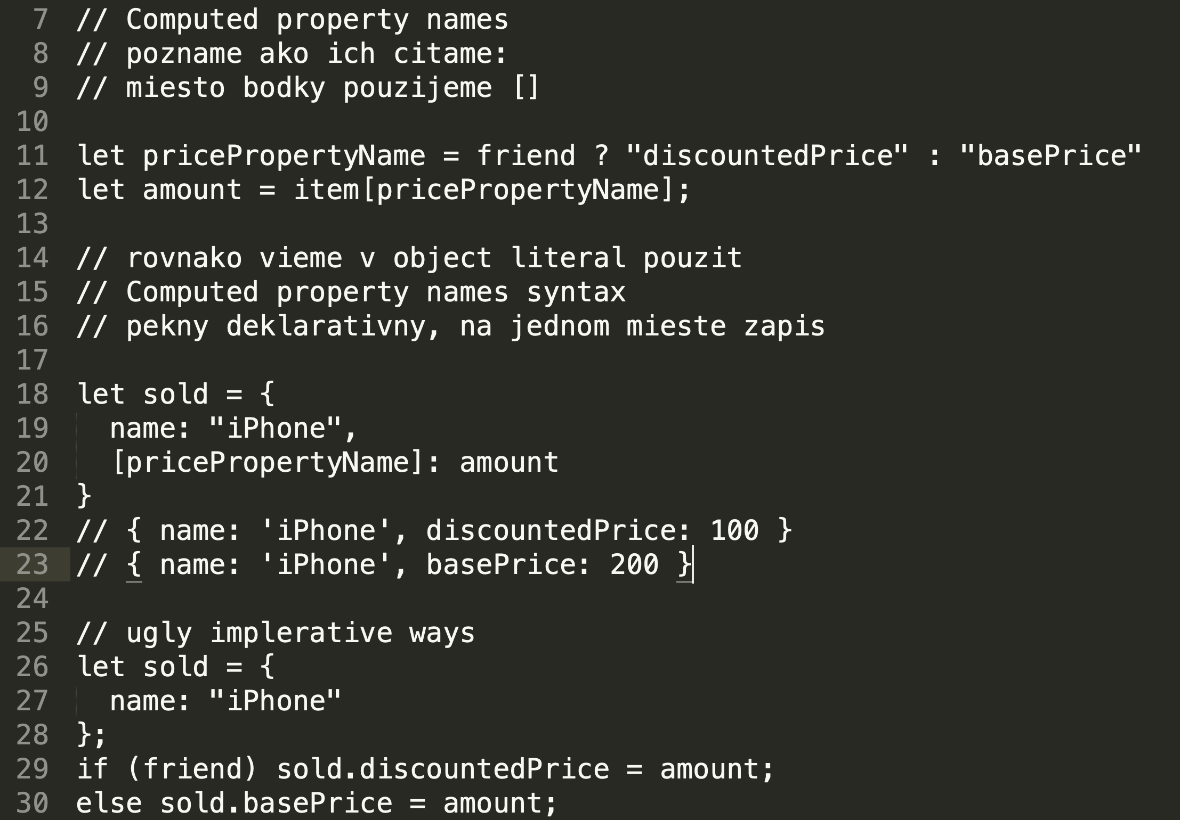

Slide 12
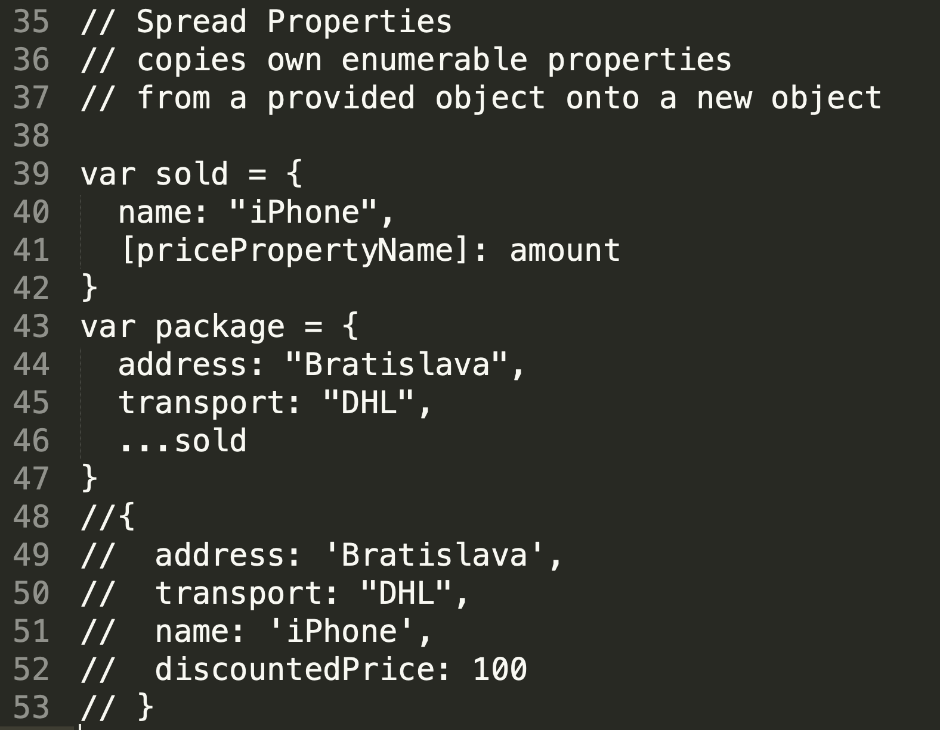

Slide 13
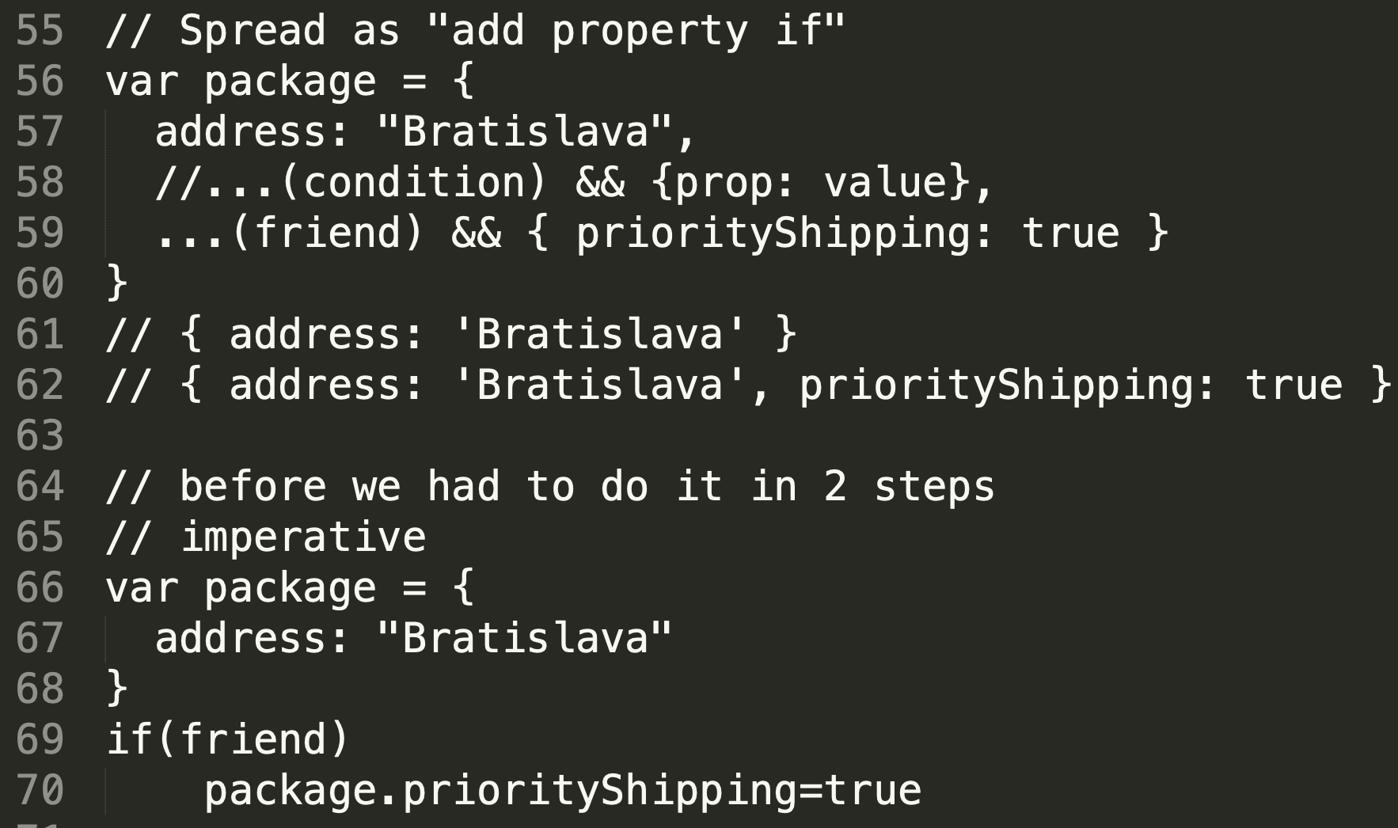

Slide 14
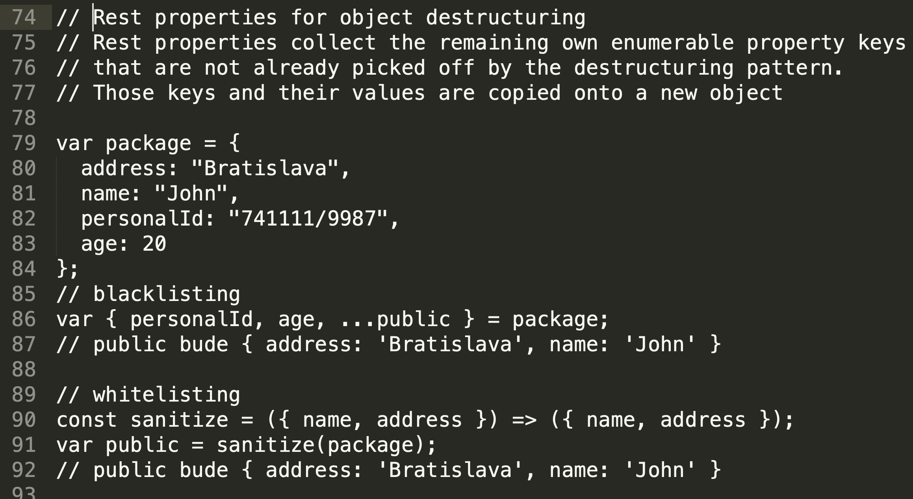

Slide 15
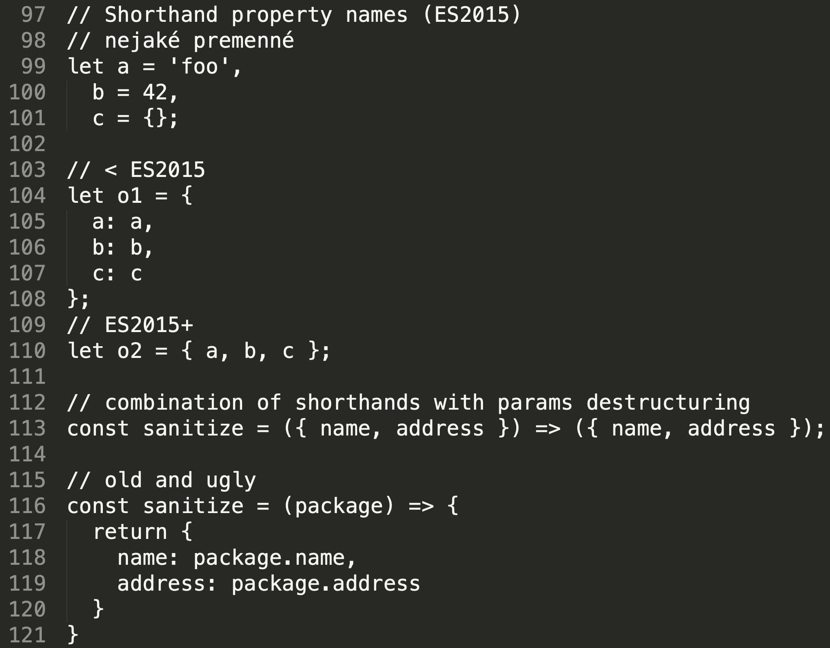

Slide 16
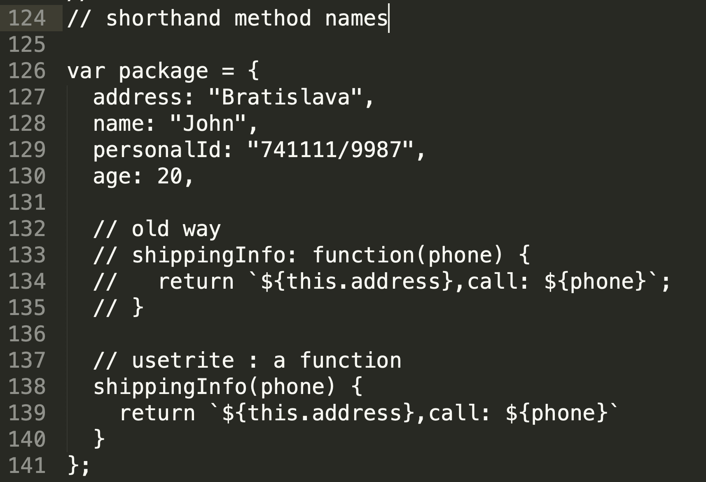

Slide 17
Getters and setters
Naco su getre a setre ?
otazka do plena …..
Kym neboli, tak bolo niekolko moznosti:
Kodli ste si o.set(prop,value), o.get(prop) (dojo framework)
Kodli ste metodu prop(value) ktora to setovala ked ste je poslali parameter a getovala ked ste ju volali bez parametra (ala jQuery)
Kodli ste setProp(value) a getProp()
Rozne proprietarne riesenia v Js enginoch browsrov
ES 5. 5.1 (2009, 2011)
The get syntax binds an object property to a function that will be called when that property is looked up.
The set syntax binds an object property to a function to be called when there is an attempt to set that property.
Syntax bud v object literal alebo v Object.defineProperty/createObject
Syntax volania gettrov a setrov je vzdy ako properties (Nie volania metod)

Slide 18
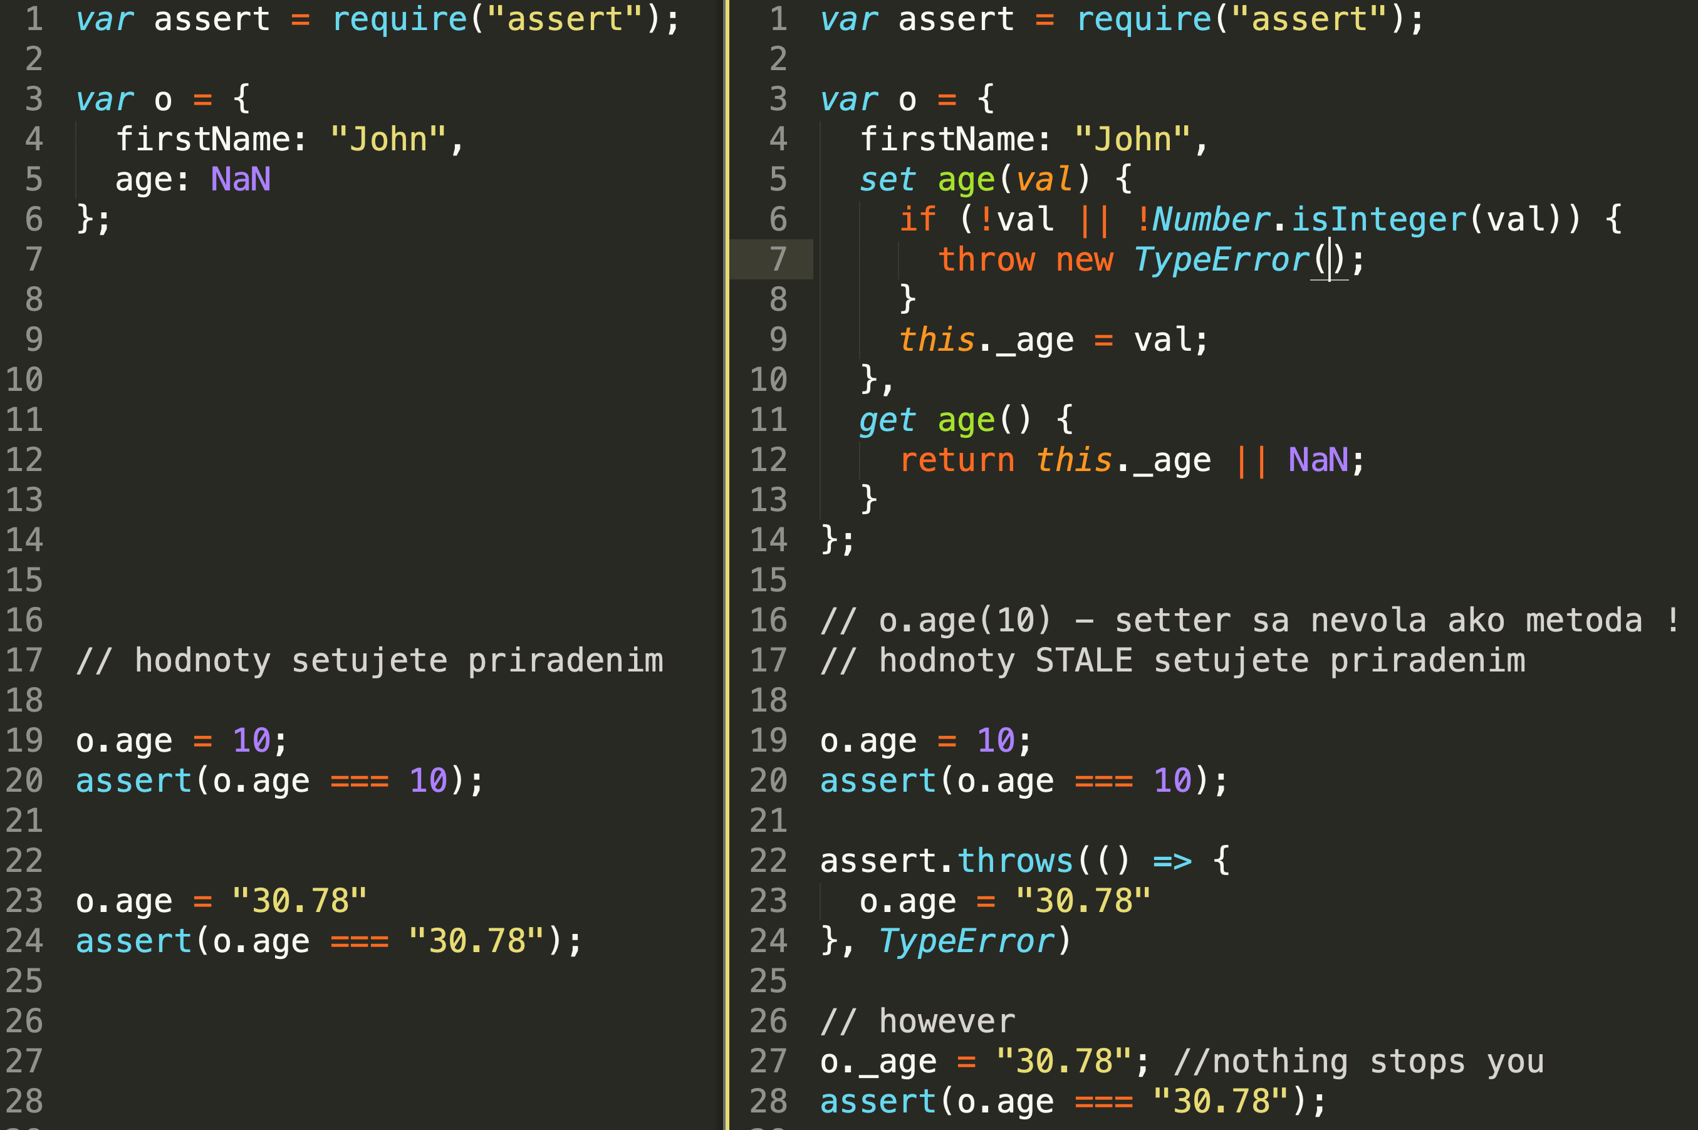

Slide 19
Getters and setters (Samples)
Reálne použitie:
určitie nie sami o sebe použiteľné na „private properties“
Validácie možných typov a hodnôt
https://github.com/nodejs/node/blob/6db45bf7def22eedfd95dac95713e850c366b169/lib/internal/http2/compat.js#L370
V kombinácii z Symbol, defineProperty, na simuláciu „private properties“ (node.js/lib/error.js) alebo readonly properties
https://github.com/nodejs/node/blob/f607e169612ff60a00f456f3c698a6b41792a8f5/lib/internal/errors.js#L113
A getter defers the cost of calculating the value until the value is needed,
Smart / self-overwriting / lazy getters
Lazy loading module dependencies https://github.com/nodejs/node/blob/f607e169612ff60a00f456f3c698a6b41792a8f5/lib/fs.js#L1843
.....
TODO: pohľadajte si použitie getrov a setrov v projektoch čo ste analyzovali na cviku1

Slide 20
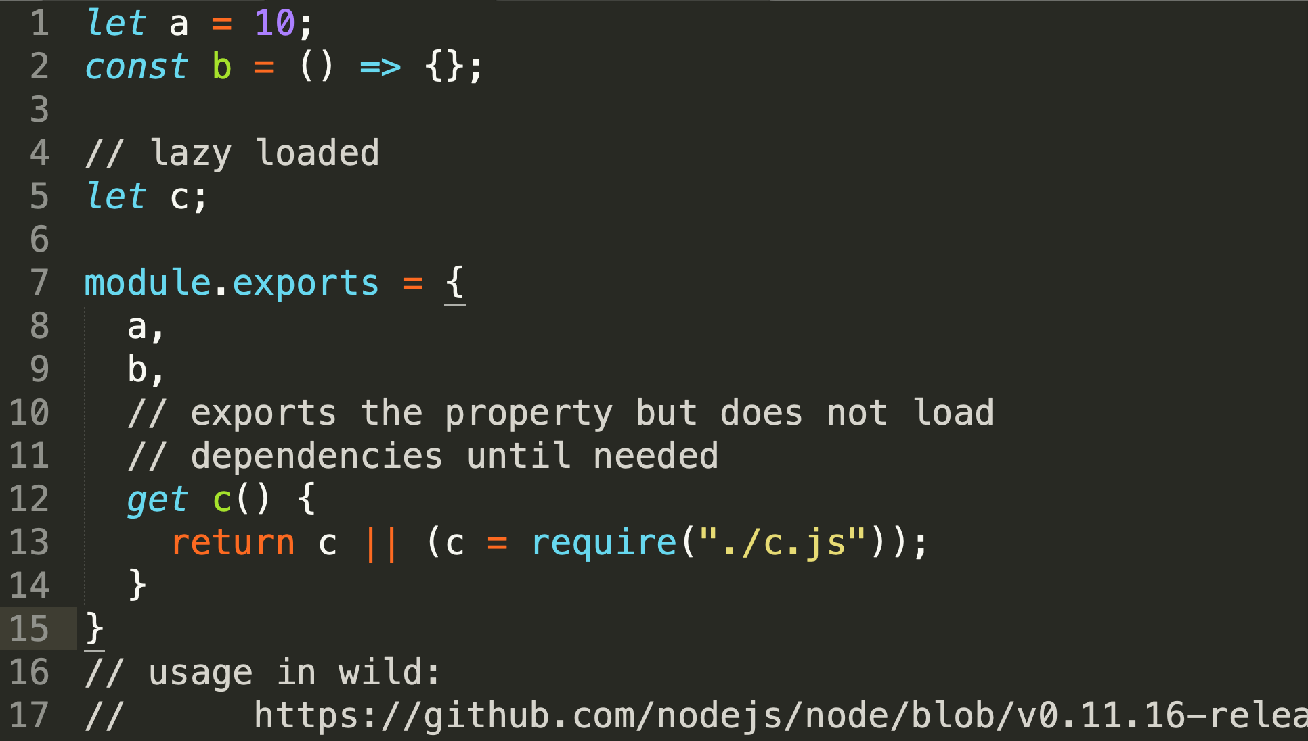
getters - lazy loaded modules (Samples)
Pattern or antipattern ? ESM vs. CJS
See lib/fs.js in node 11 for lazy loaded modules
TODO: .....

Slide 21
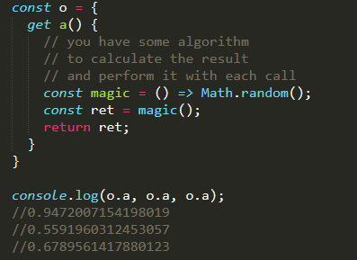
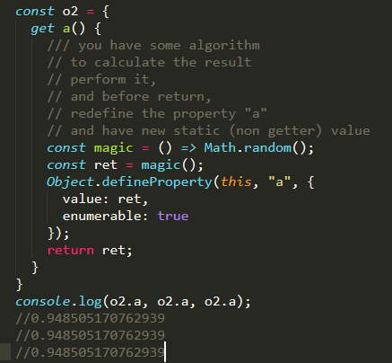
self-overwriting / lazy getters (Samples)

Slide 22
Druhy properties: writable, enumerable, configurable
by default all properties defined with traditional syntax are writable, enumerable, configurable
Object.defineProperty, Object.create methods - allows a precise addition to or modification of a property on an object : môžete vytvárať objekty ktoré
majú readonly properties
majú hiden (non enumerable) properties, ktoré sa neobjavia pri enumerácii pomocou for in, alebo Object.keys()
a nedajú sa zmazať (ani zmeniť ich správanie, configurable)
Bezpečnejšie API, immutable, ....
https://developer.mozilla.org/en-US/docs/Web/JavaScript/Reference/Global_Objects/Object/defineProperty,
https://developer.mozilla.org/en-US/docs/Web/JavaScript/Enumerability_and_ownership_of_properties

Slide 23
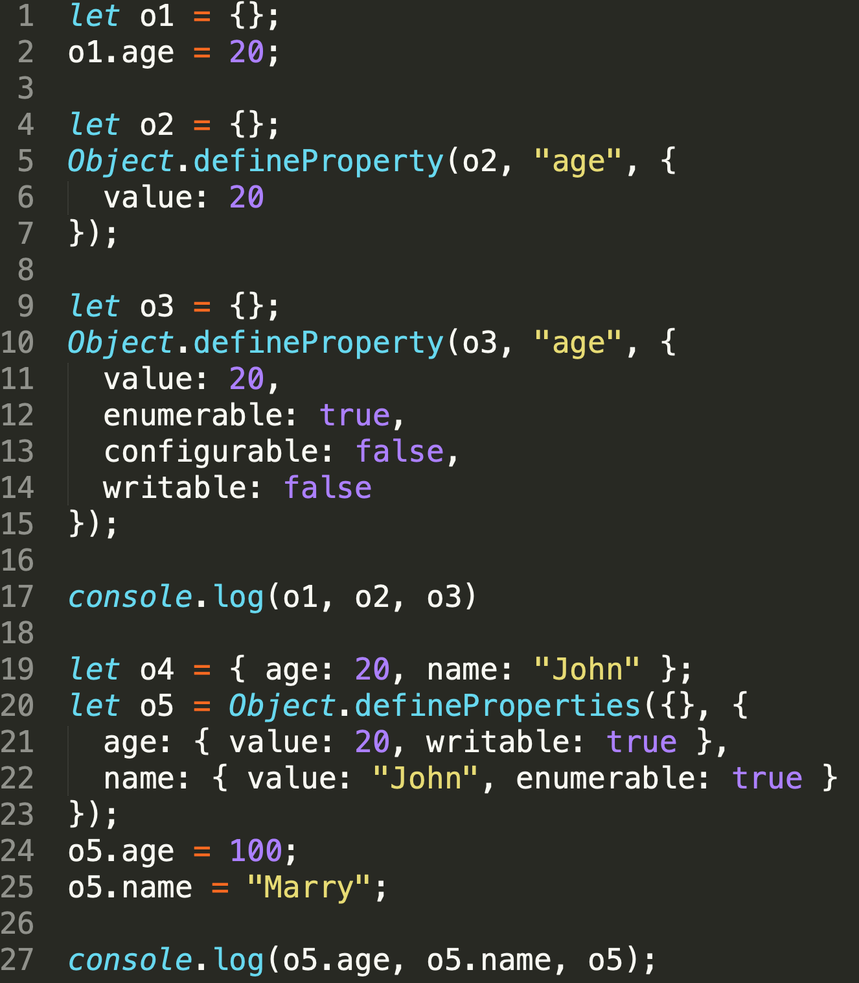
writable, enumerable, configurable Object.defineProperty
This method allows a precise addition to or modification of a property on an object. Normal property addition through assignment creates properties which show up during property enumeration (for...in loop or Object.keys method), whose values may be changed, and which may be deleted. This method allows these extra details to be changed from their defaults.

Slide 24
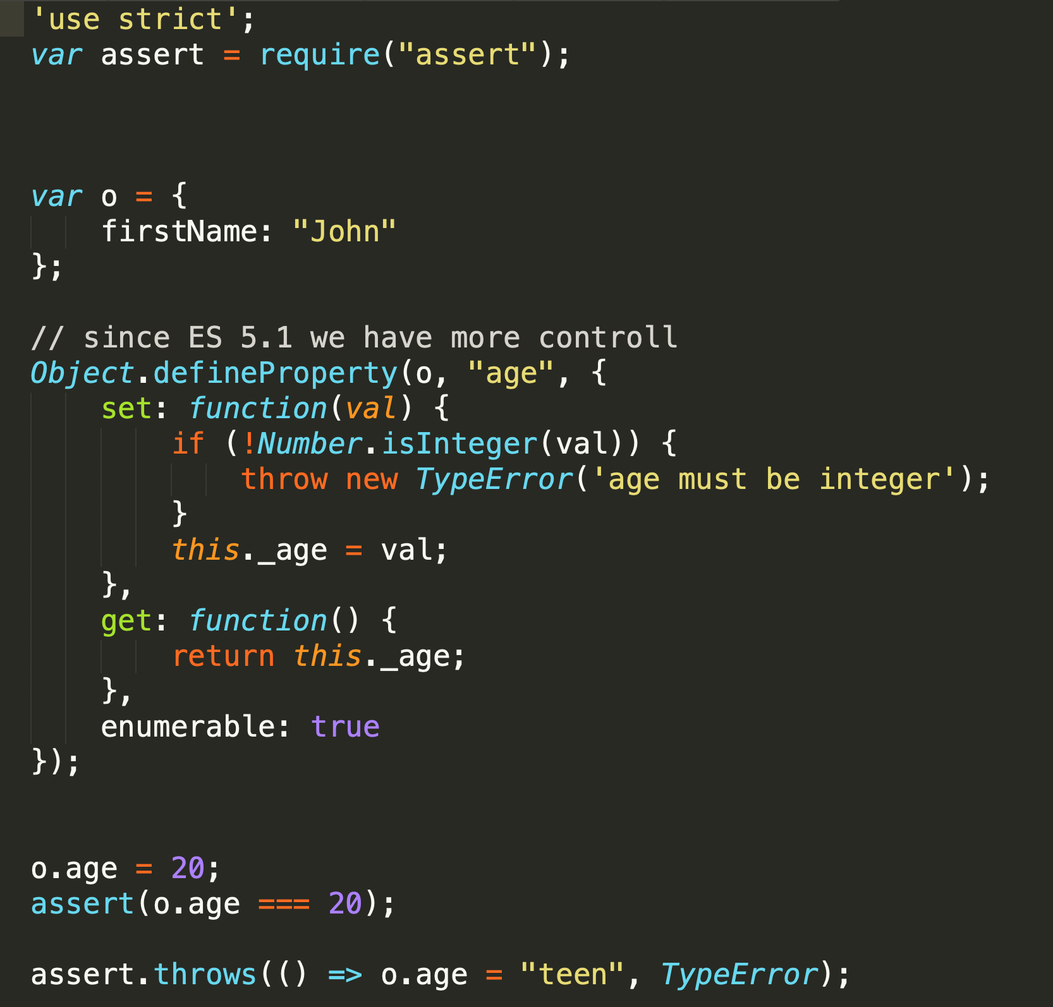
writable, enumerable, configurable Object.defineProperty
Dve možnosti pre parameter:
Accessor Descriptor (vid kod vedla)
configurable
enumerable
set
get
Data descriptor (dalsie slajdy|
configurable
enumerable
writable
value
Kombinácia writable,value a set, get nedáva zmysel, musíte si vybrať ako idete riešiť hodnoty v tej property
definePropery, defineProperties a createObject je teda okrem string literal druha moznost kde definovat getre a setre

Slide 25
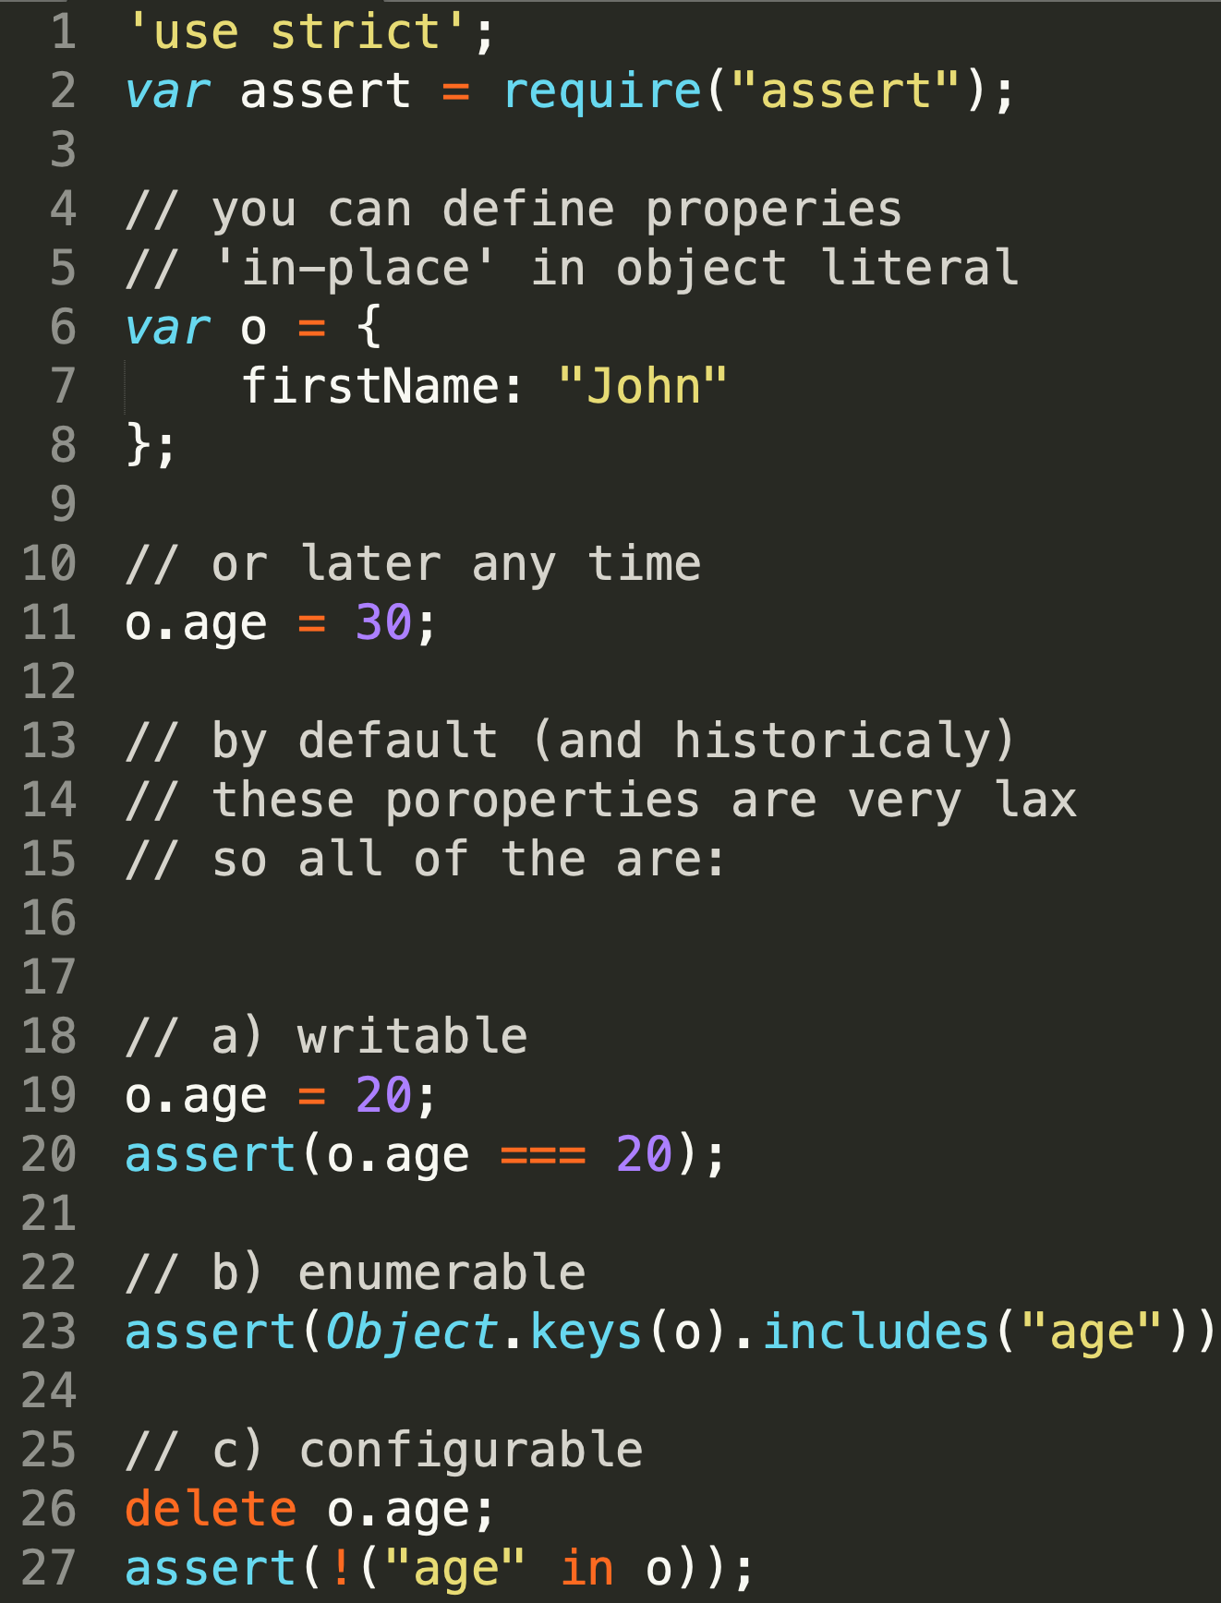
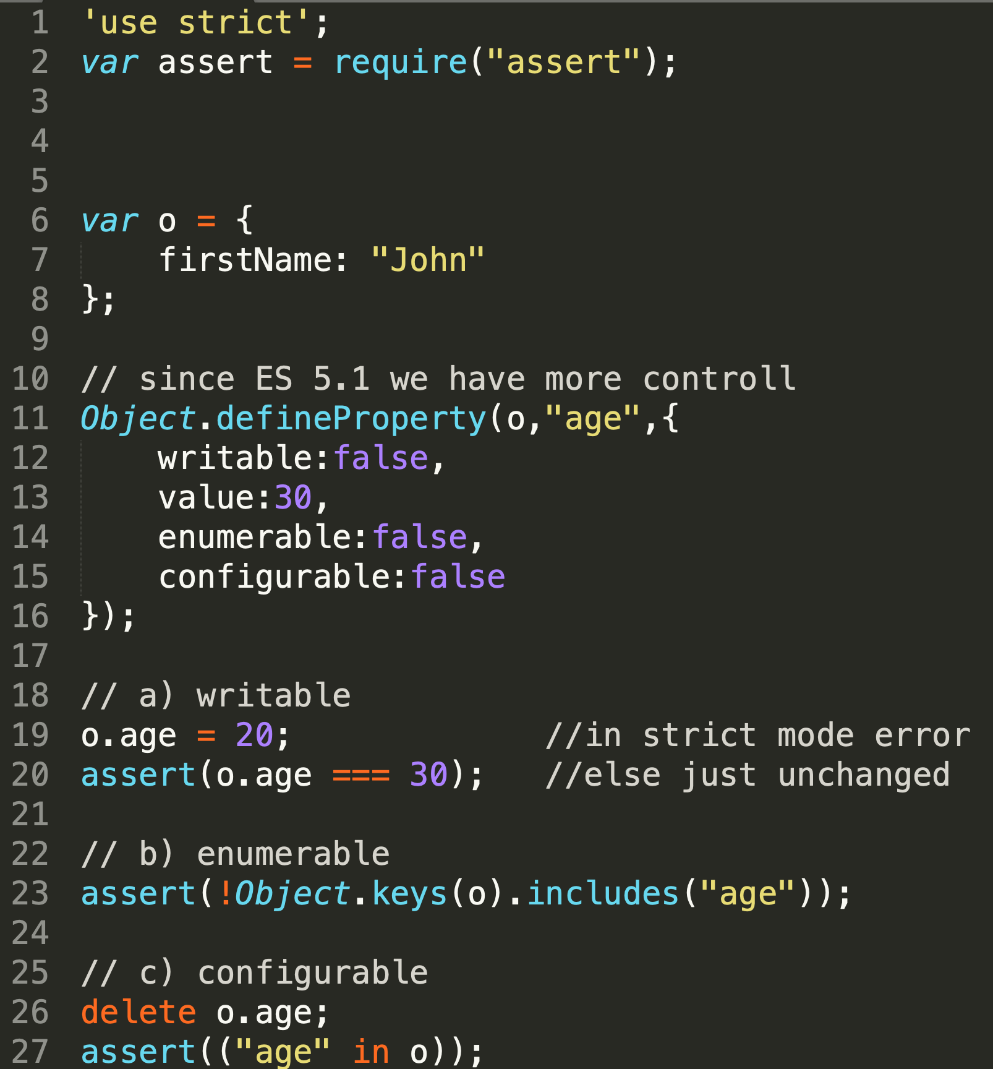



Slide 26
Použitie writable, enumerable, configurable
enumerable: false
...
...
configurable: false
...
...
writable: false
...
...
V kombinácii z Symbol ale aj normálnymi properties

Slide 27
Symbols

Slide 28
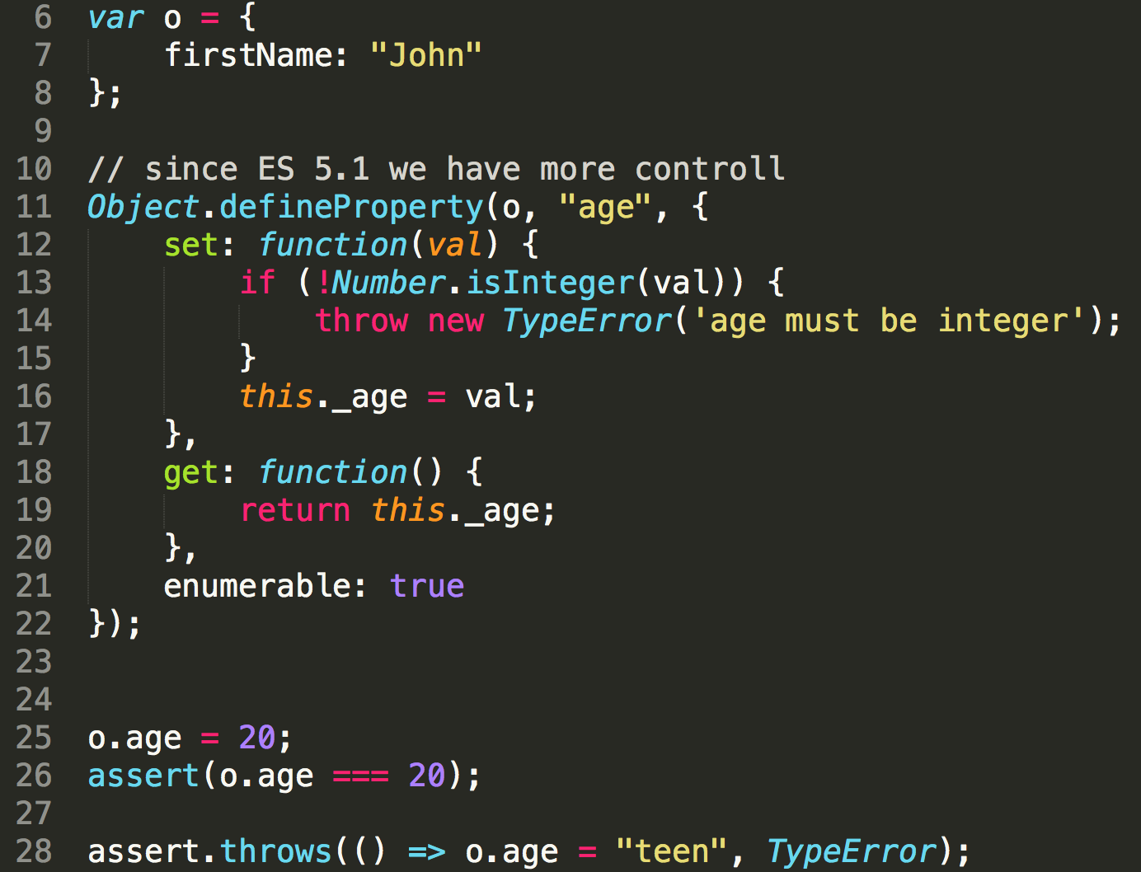
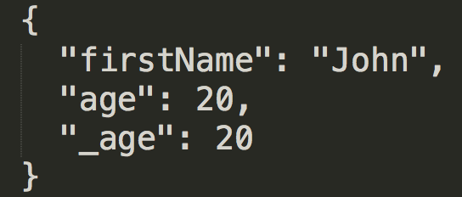
No Symbols (original code)
Resulting object has age property (backed by setter and getter and is enumerable because we have specified so)
However it has unwanted _age property, problem with _age is
it is enumerable
it is ugly (we have to come up with pseudo private names)
Both can be fixed in several ways...

Slide 29

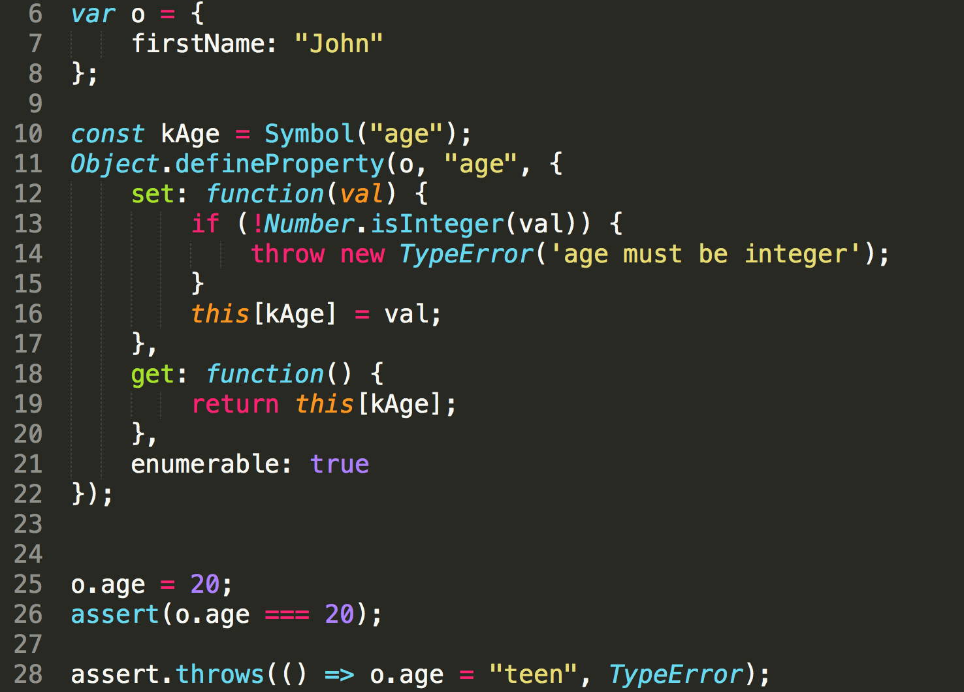
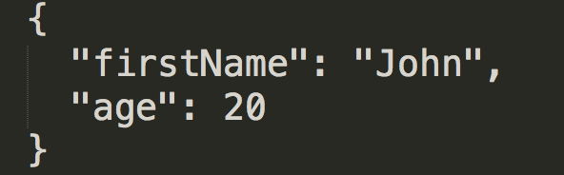
With Symbols

Slide 30
Symbol
RECAP: The data type "symbol" is a primitive data type
This data type is used as the key for an object property when the property is intended to be private, for the internal use of a class or an object type
When a symbol value is used as the identifier in a property assignment, the property (like the symbol) is anonymous; and also is non-enumerable.
non-emuberable means it will not show in for( ... in ...)",
anonymous, it will not show up in the result array of "Object.getOwnPropertyNames()".

Slide 31
Prototypes and Inheritance
inheritance in JavaScript

Slide 32
No Classes – understanding prototypes
To understand prototypes in JS stop thinking about classes and instances, there is only one thing the instance (or we just call it object)
There are several syntaxes for creating objects and achieving inheritance
people always tried not to understand prototypes and mimic classes in JS,
there are too many libraries,
JS comitee probably gave up ;-( and made classes part of language
since 1: function P(); P.prototype=;new P();
since 5.1: Object.createObject
...
...
since 2015: classes
Object.createObject will be used in following lecture as the most understandable concept of inheritance with prototypes

Slide 33

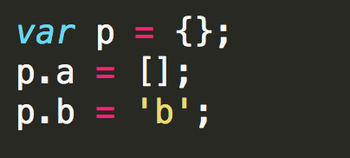
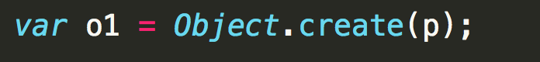
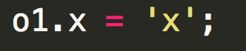
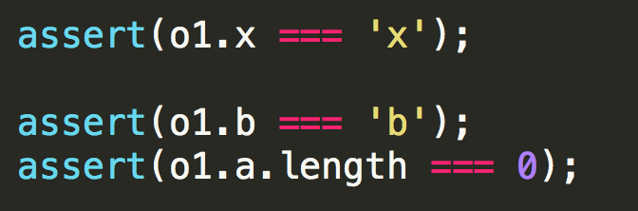
prototypes
p
a:[]
b:'b'
o1
x:'x'

Slide 34
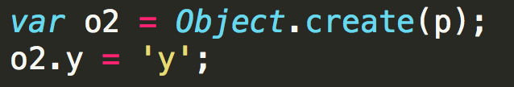
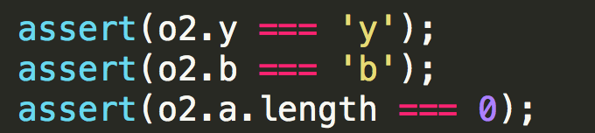
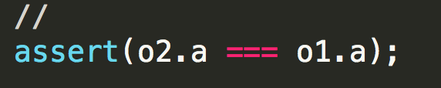
prototypes
p
a:[]
b:'b'
o1
o2
x:'x'
y:'y'

Slide 35

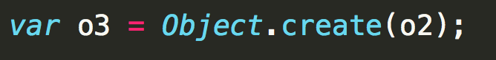
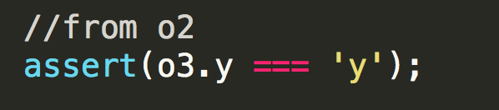
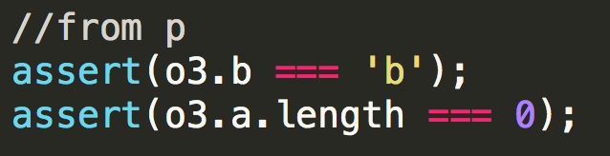
prototypes
p
a:[]
b:'b'
o1
o2
x:'x'
y:'y'
o3

Slide 36
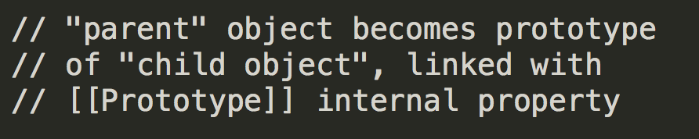
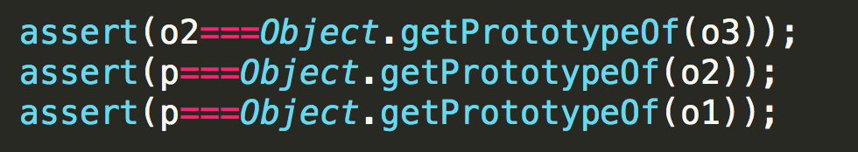
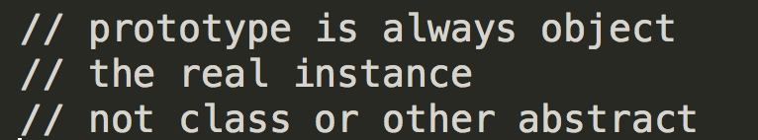
prototypes
instance
p
a:[]
b:'b'
[[Prototype]]
instance
instance
o1
o2
x:'x'
y:'y'
instance
[[Prototype]]
o3

Slide 37
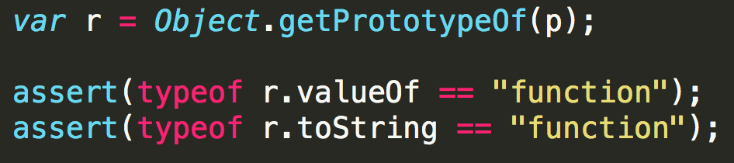
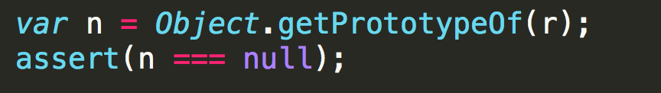
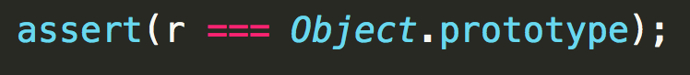
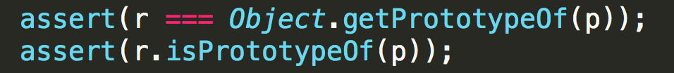
prototypes
null
isPrototypeOf()
r {}
Object.prototype
toString()
...
p
a:[]
getPrototypeOf()
b:'b'
[[Prototype]]
o1
o2
x:'x'
y:'y'
[[Prototype]]
o3

Slide 38
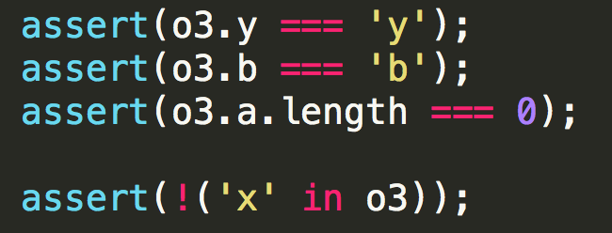
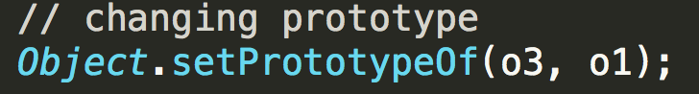
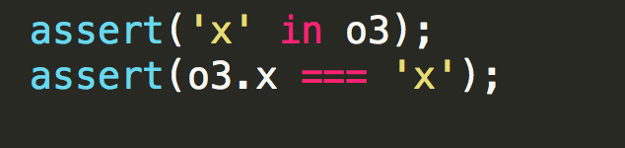
prototypes
null
Object.prototype
toString()
...
p
a:[]
b:'b'
[[Prototype]]
o1
o2
x:'x'
y:'y'
[[Prototype]]
o3

Slide 39

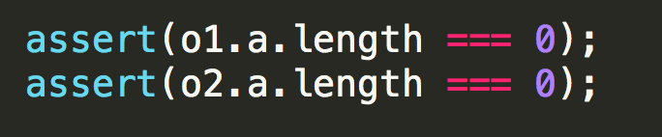
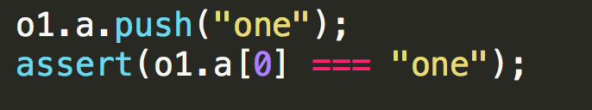

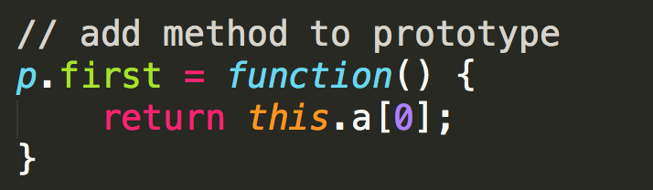
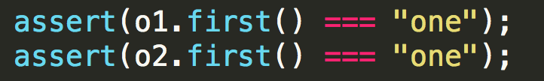
prototypes
p
a:[]
a:['one']
b:'b'
m:function
o1
o2
x:'x'
y:'y'

Slide 40
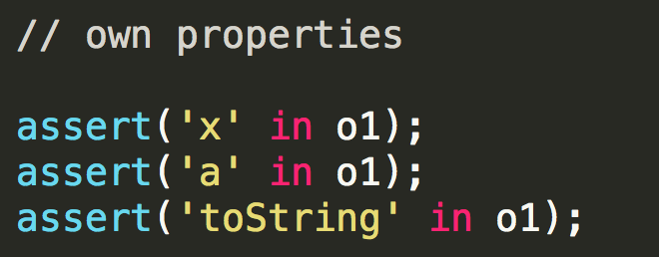
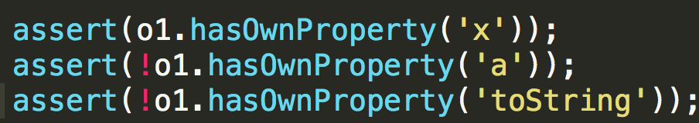
prototypes
null
null
r {}
r {}
toString:()
toString:()
...
...
p
p
a:[]
a:[]
b:'b'
b:'b'
toString:()
...
o1
o1
x:'x'
x:'x'
a:[]
b:'b'
toString:()
...

Slide 41
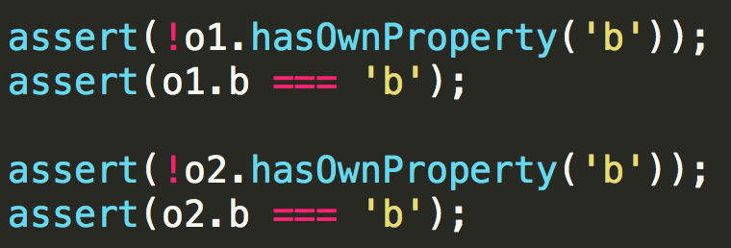
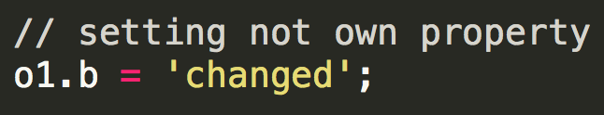
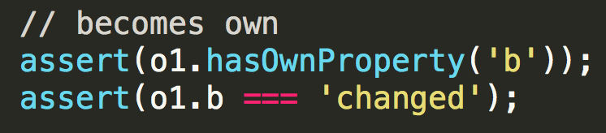
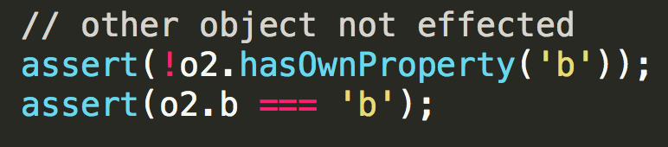
prototypes
null
r {}
toString:()
...
p
a:[]
b:'b'
toString:()
...
o1
o2
x:'x'
y:'y'
a:[]
a:[]
b:'changed'
b:'b'
b:'b'
toString:()
toString:()
...
...

Slide 42
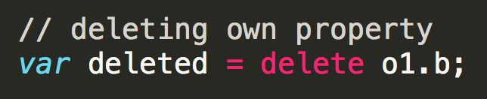




prototypes
null
r {}
toString:()
...
p
a:[]
b:'b'
toString:()
...
o1
o2
x:'x'
y:'y'
a:[]
a:[]
b:'changed'
b:'b'
b:'b'
toString:()
toString:()
...
...

Slide 43


prototypes
null
r {}
toString:()
...
p
a:[]
b:'b'
data properties on the instance prototype is a bad idea.
really ?
toString:()
...
o1
o2
x:'x'
y:'y'
a:[]
a:[]
b:'b'
b:'b'
toString:()
toString:()
...
...

Slide 44
Syntax for creating objects
RECAP:
since 1:
function P(); P.prototype=;new P();
since 5.1:
Object.createObject
since 2015:
classes

Slide 45





prototypes – constructors and new
instanceof
this is where
JS started
to be "classy"

Slide 46


prototypes – constructors and new
null
[[Prototype]]
Object.prototype
function Object
toString()
...
[[Prototype]]
prototype
P.prototype
function P
a:[]
constructor
b:'b'
new
constructor
[[Prototype]]
o1
o2
x:'x'
y:'y'
instanceof

Slide 47


prototypes – hierarchies
null
[[Prototype]]
Object.prototype
function Object
toString()
...
[[Prototype]]
prototype
P.prototype
function P
a:[]
constructor
b:'b'
new
???
[[Prototype]]
o1
o2
function CH
y:'y1'
y:'y2'
and this why we have so many "inheritance libraries" and finally ES classes
new
[[Prototype]]
o3

Slide 48


prototypes – hierarchies
null
[[Prototype]]
Object.prototype
function Object
toString()
...
[[Prototype]]
prototype
P.prototype
function P
a:[]
constructor
b:'b'
createObject
[[Prototype]]
[[Prototype]]
o1
o2
function CH
CH.prototype
y:'y1'
new
[[Prototype]]
o3
y:

Slide 49



prototypes – hierarchies
null
[[Prototype]]
Object.prototype
function Object
toString()
...
[[Prototype]]
prototype
P.prototype
function P
a:[]
constructor
b:'b'
createObject
new
[[Prototype]]
[[Prototype]]
o1
o2
function CH
CH.prototype
y:'y1'
new
[[Prototype]]
o3
y:

Slide 50
inheritance
Celé je to o:
prototypes and instances
own and not-own properties
o tom načo dedenie používate ako implementačný pattern a ako ďalej z objektami pracujete:
či vám striktne záleží na použití a dodrzčaní instanceof (načo) ?
či vám záleží na tom či je priperty own alebo inherited
reuse funkcionality
reuse dat a delegacia
...
https://www.crockford.com/javascript/inheritance.html
Classical Inheritance,
Swiss Inheritance,
Parasitic Inheritance,
Class Augmentation
and Object Augmentation.
This large set of code reuse patterns comes from a language which is considered smaller and simpler than Java. Classical objects are hard. The only way to add a new member to a hard object is to create a new class. In JavaScript, objects are soft. A new member can be added to a soft object by simple assignment.
Because objects in JavaScript are so flexible, you will want to think differently about class hierarchies. Deep hierarchies are inappropriate. Shallow hierarchies are efficient and expressive.

Slide 51
classes
ES5.1 createObject
ES3 functions and prototypes
ES2015 classes
?
class P
a:[]
b:'b'
extends
class CH

Slide 52



classes, prototypes syntax

Slide 53
classes, prototypes, tech
null
[[Prototype]]
Object.prototype
function Object
toString()
...
classes are funtcions
class body is prototype
extends sets prototype of prototype
extends sets prototype of function to parent class function
instance variables are set in constructors
[[Prototype]]
prototype
class P
P.prototype
function P
a:
constructor
a:
b:
b:
constructor
[[Prototype]]
[[Prototype]]
[[Prototype]]
extends
o1
o2
function CH
class CH
CH.prototype
y:'y1'
constructor
new
[[Prototype]]
o3
y:

Slide 54

inheritance custom
util.inherits(constructor, superConstructor)
YUI
TODO: others

Slide 55

Prototype related APIs
Prototype related APIs
TODO: exploratory testing na vlastných príkladoch na cvičeniach

Slide 56
Definitions (at the end)
Prototype-based programming is a style of object-oriented programming in which behaviour reuse (known as inheritance) is performed via a process of reusing existing objects via delegation that serve as prototypes. This model can also be known as prototypal, prototype-oriented, classless, or instance-based programming. Delegation is the language feature that supports prototype-based programming. (wikipedia)
JavaScript objects are dynamic "bags" of properties (referred to as own properties). JavaScript objects have a link to a prototype object. When trying to access a property of an object, the property will not only be sought on the object but on the prototype of the object, the prototype of the prototype, and so on until either a property with a matching name is found or the end of the prototype chain is reached. (MDN)
TODO: find more definitions in suggested literature

Slide 57
Introspection
JS is dynamic language, and this is more then needed and used

Slide 58
Introspection
What is enumerable and why it is important
In computing, type introspection is the ability of a program to examine the type or properties of an object at runtime.
Introspection should not be confused with reflection, which goes a step further and is the ability for a program to manipulate the values, meta-data, properties and/or functions of an object at runtime.
Since JS is dynamic language introspection and reflection is natural feature

Slide 59

Introspection enumerating properties
A for...in loop only iterates over enumerable, non-Symbol properties.
Enumerable properties are those properties whose internal enumerable flag is set to true,
which is the default for properties created via simple assignment or via a property initializer
properties defined via Object.defineProperty and such default enumerable to false.
Enumerable properties show up in for...in loops unless the property's key is a Symbol.
Objects created from built–in constructors like Array and Object have inherited non–enumerable properties from Object.prototype and String.prototype, such as String's indexOf() method or Object's toString() method.
The loop will iterate over all enumerable properties of the object itself and those the object inherits from its constructor's prototype

Slide 60

Introspection in operator
The in operator returns true if the specified property is in the specified object or its prototype chain
A string or symbol representing a property name or array index (non-symbols will be coerced to strings).

Slide 61

Introspection API
okrem for...in loop statementu a in operatora je väčšina introspection API na Object.*

Slide 62

Introspection API - hasOwnProperty
hasOwnProperty() method returns a boolean indicating whether the object has the specified property as its own property (as opposed to inheriting it).
často používaná v spojení s for..in statementom
alebo namiesto in operatora ak nas zaujimaju iba nase properties
beware, object can override the property, so it is better called with Object.prototype.hasOwnProperty

Slide 63

Checking if object has property
how to chcek if the object has some property
a) depends on if you create the object yourself
v1,v2
b) or you receive it as param
v3
c) what are expected corect values (Falsy values)
of assigned properties
functions, objects,
numbers, strings

Slide 64
Introspection API
TODO: na cvičeniach si napísať exploratity test na kazde z tych API

Slide 65

enumerable and own
pochopenie enumerable a own konceptov je potrebné pre správne používanie jazyka, API a pochopenie ďalších konceptov

Slide 66
Summary
rozumieť dedeniu – poznať variácie zápisov pri konštrukcii objektov
{x:},o.y=
createObject
new MyFunction()
new MyClass()
vedieť používať getre setre
readonly properties
dokázať rozlíšiť medzi own a not-own properties
enumerable a non enumerable
getter a setter
dokazat povedat rozdiel medzi if(x 'in' o), if(o.x), if(typeof o.x === 'undefined'),....

Slide 67


own and inherited properties
RECAP: property access is delegated from object to prototypes if not found on the object
method of parent may use properties never defined on parent (we are JS ;-)))

Slide 68
overriding inherited property/method
null
r {}
toString:()
...
p
a:[]
b:'b'
toString:()
...
o1
o2
x:'x'
y:'y'
a:[]
a:[]
b:'changed'
b:'b'
b:'b'
toString:()
toString:()
...
...

Slide 69

Missing Topics
Na ďalších prednáškach budeme rozoberať
transformácie objektov (FP)
porovnávanie objektov
serializáciu deserializáciu
traverzovanie
....
dediť z node.js tried (Streams)
....

Slide 70

_aux

Slide 71
Some links
https://developer.mozilla.org/en-US/docs/Web/JavaScript/Guide/Details_of_the_Object_Model
https://medium.com/@robertgrosse/how-es6-classes-really-work-and-how-to-build-your-own-fd6085eb326a
https://www.sitepoint.com/object-oriented-javascript-deep-dive-es6-classes/

